Slide 1
Cleaning Week 5

Slide 2
In pairs
1.10.1976
5/4/2020
1678-30-01
04-07-2023
Dec, 1, 1849
Answer three questions:
What are we looking at?
Why does it matter?
How could you address and fix the problem? Document in DETAIL each step to doing so.
Notes:
Actual job interview question!

Slide 3
What is cleaning?
What are different ways to clean?
What were take aways from the podcast episode?
Why do it?

Slide 4
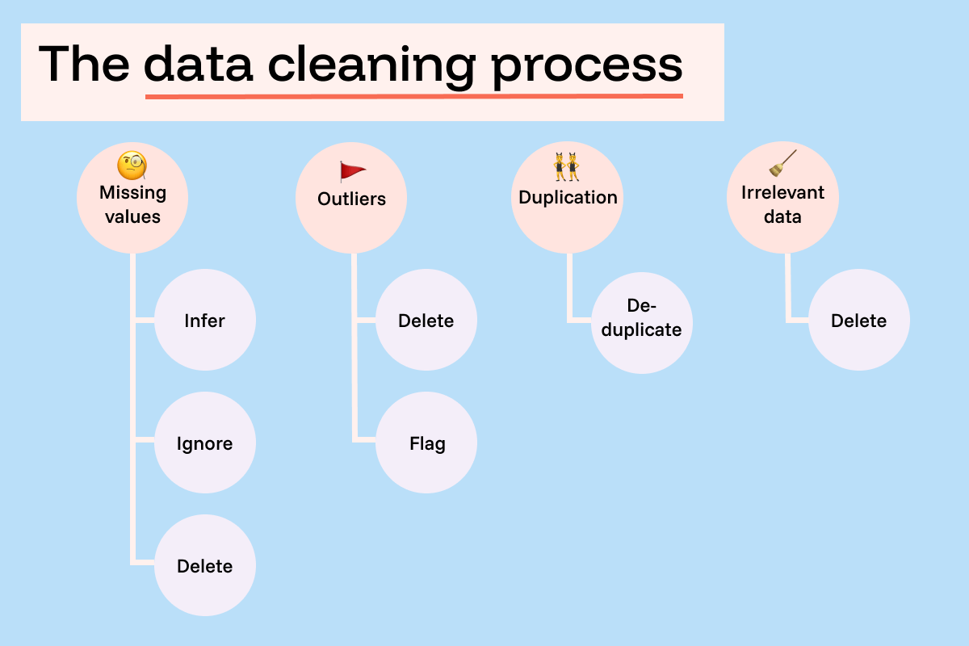
Notes:
https://funnel.io/blog/what-is-data-cleaning-your-complete-guide

Slide 5
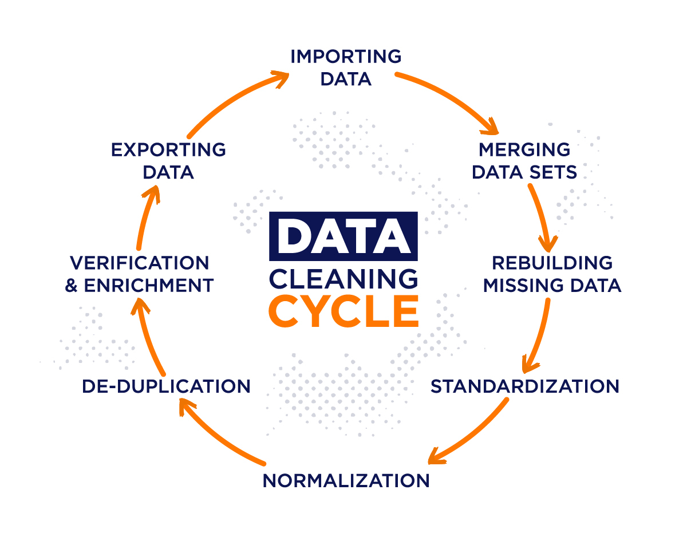
Notes:
From https://airbyte.com/data-engineering-resources/data-cleansing

Slide 6
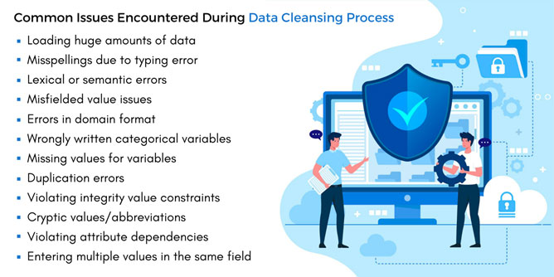
Notes:
https://www.markovml.com/blog/automated-data-cleaning

Slide 7
5 characteristics of quality data
Validity. The degree to which your data conforms to defined business rules or constraints.
Accuracy. Ensure your data is close to the true values.
Completeness. The degree to which all required data is known.
Consistency. Ensure your data is consistent within the same dataset and/or across multiple data sets.
Uniformity. The degree to which the data is specified using the same unit of measure.
Notes:
https://www.tableau.com/learn/articles/what-is-data-cleaning

Slide 8
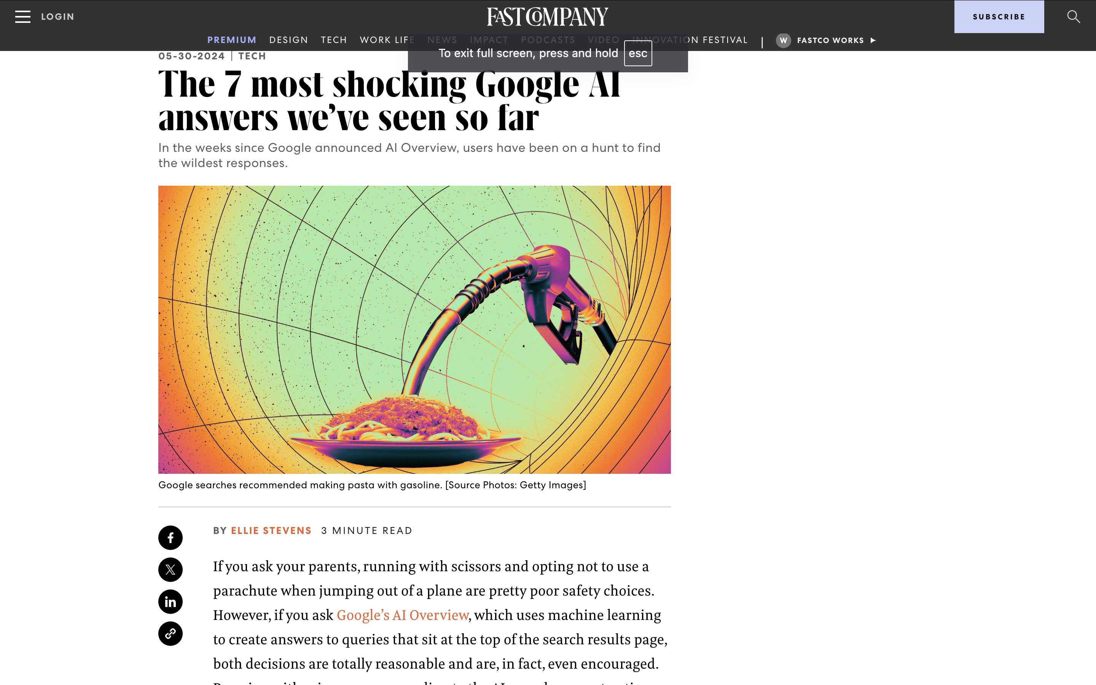
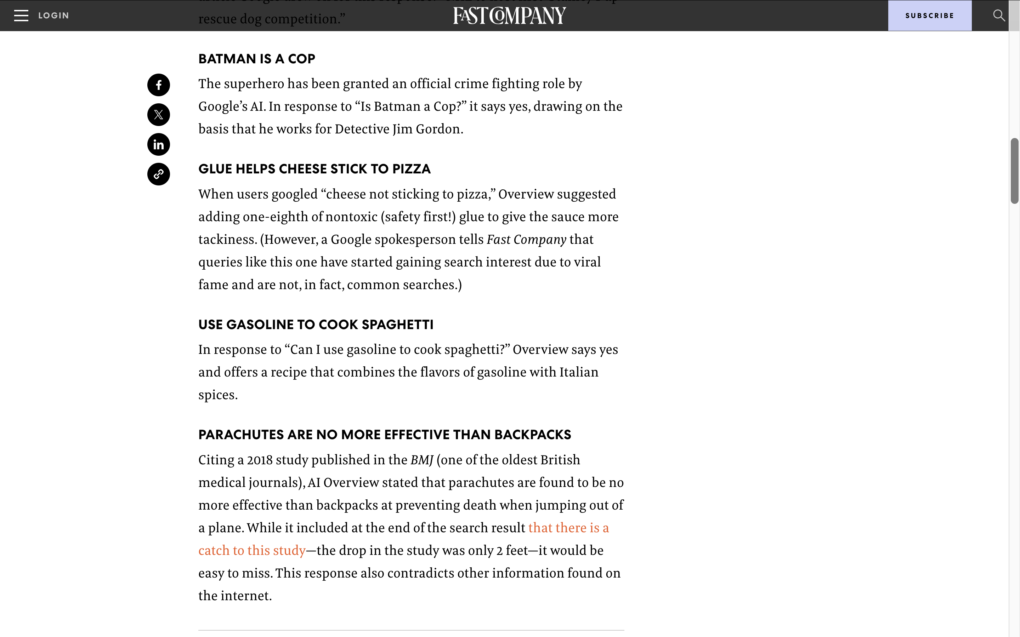
Why Clean
Ensures your analysis is correct
In some cases, clean data means you can actually analyze in the first place!
Will keep you off the front page of the news

Slide 9
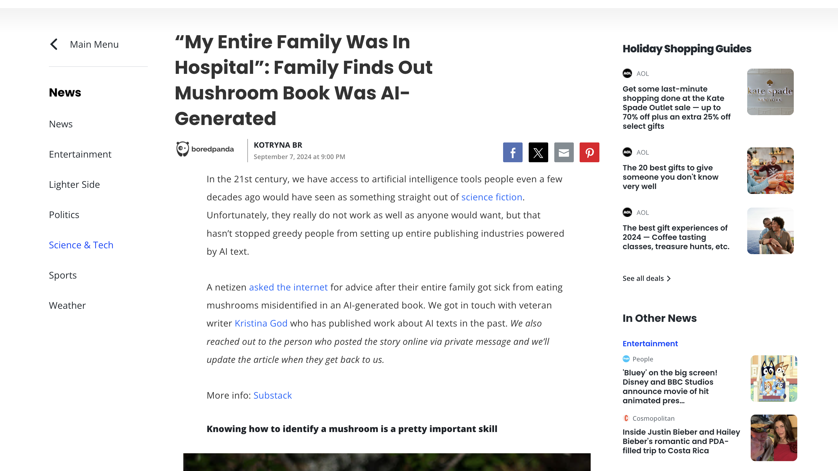
Notes:
Also saves lives

Slide 10
Why Not Clean?
Eliminating difference
Exerting authority over the data (what if they are people?)
“Messy” and “Clean” imply an order that might not exist in life
Perfect might be the enemy of the good

Slide 11
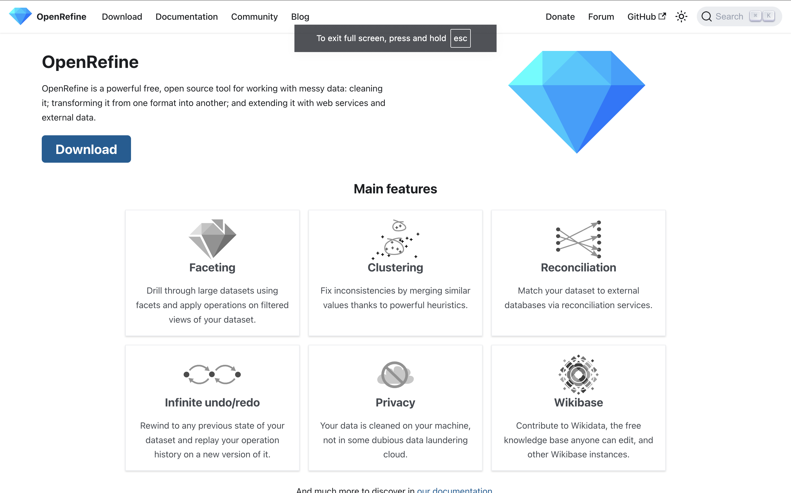
Open Refine Workshop

Slide 12
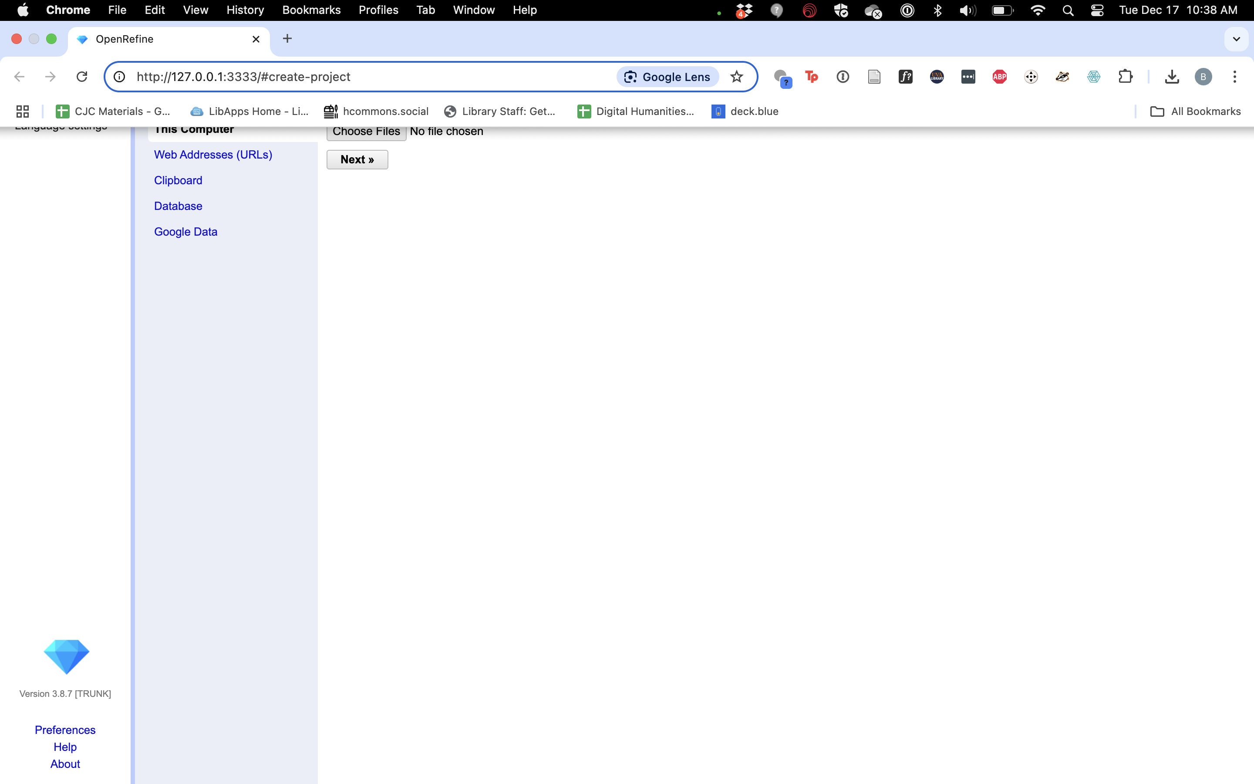
Before Session
Visit https://bit.ly/D4US-audible and download both the uncleaned version and the cleaned one.
Scroll down and select them under “data explorer”
Then click the download button at left for each
You’ll be asked to make an account
Download and install OpenRefine
Once you open it you should see OR launch in a browser window
Note the URL

Slide 13
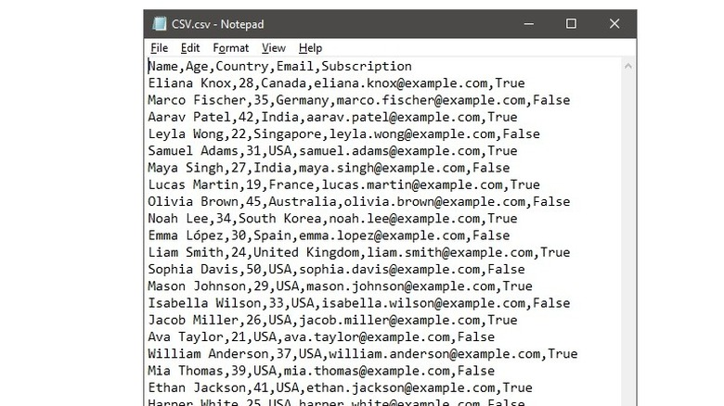

Slide 14
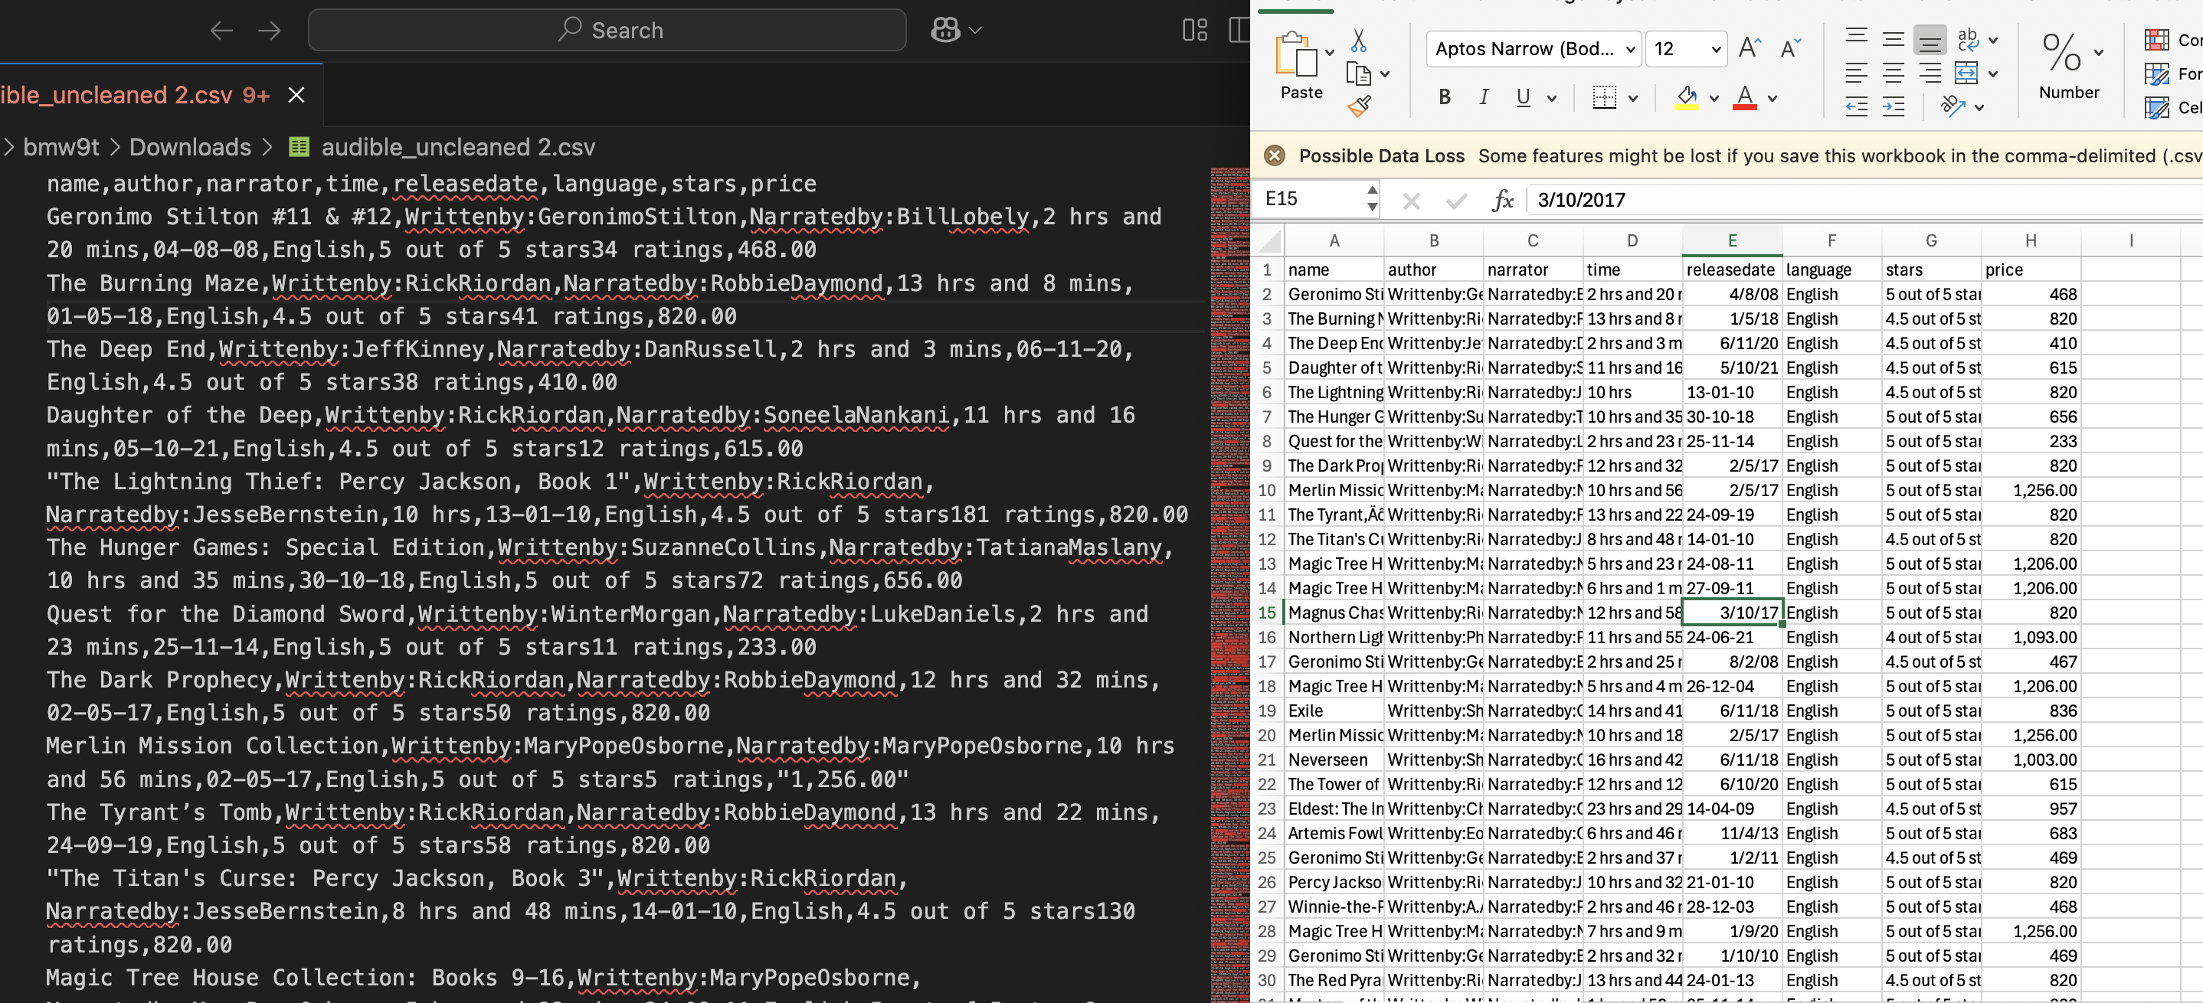
Notes:
Same data side by side

Slide 15
Setup
When you launch OpenRefine it opens in a browser window
Note the URL
Choose file -> select the uncleaned audible zip to upload -> next

Slide 16
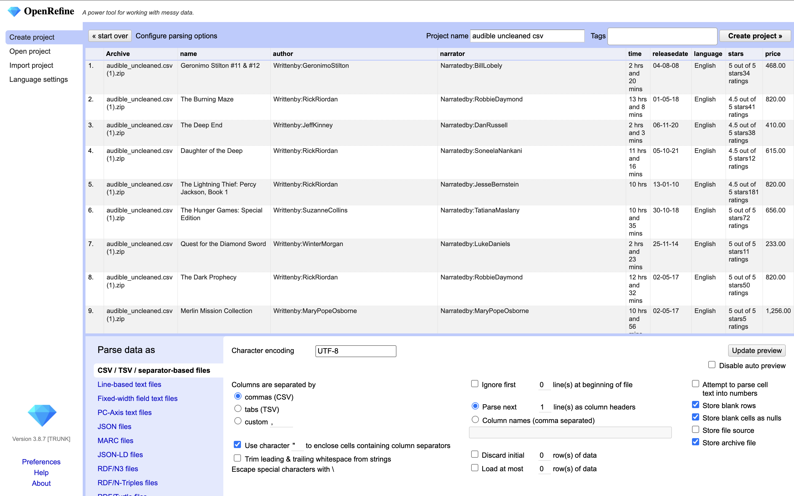
Interface
Data at top
Parsing Info at bottom
This is where you would make a lot of decisions about how to import your data like…
Language
Formatting
Create the project
Leave everything the same and hit “Create Project”

Slide 17
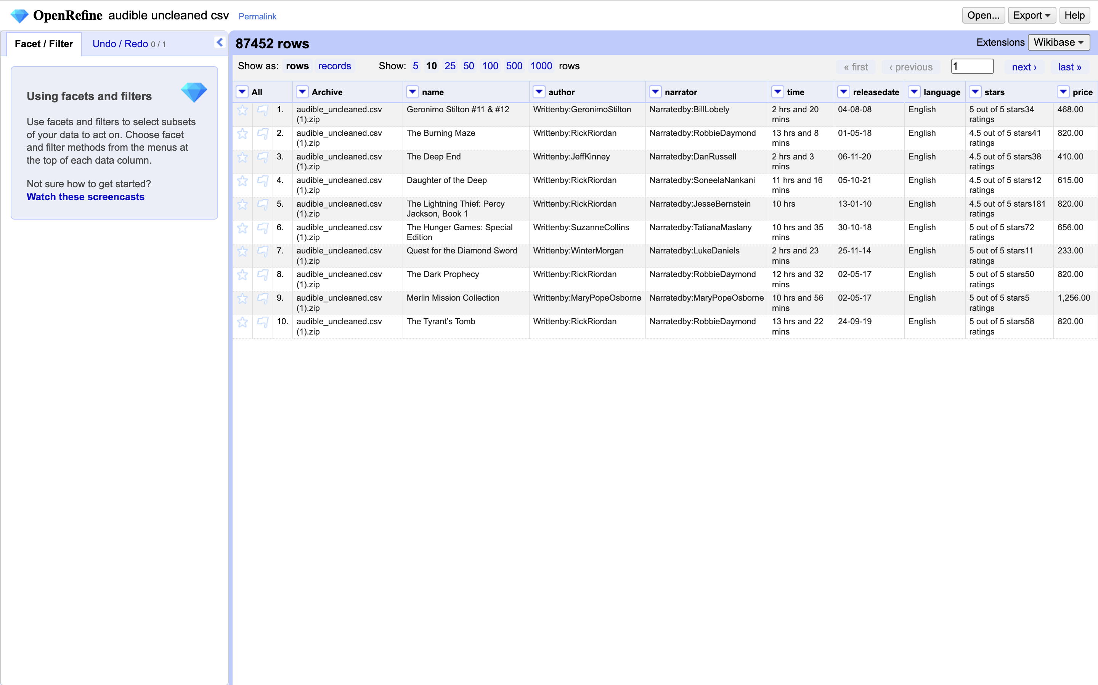
Interface

Slide 18
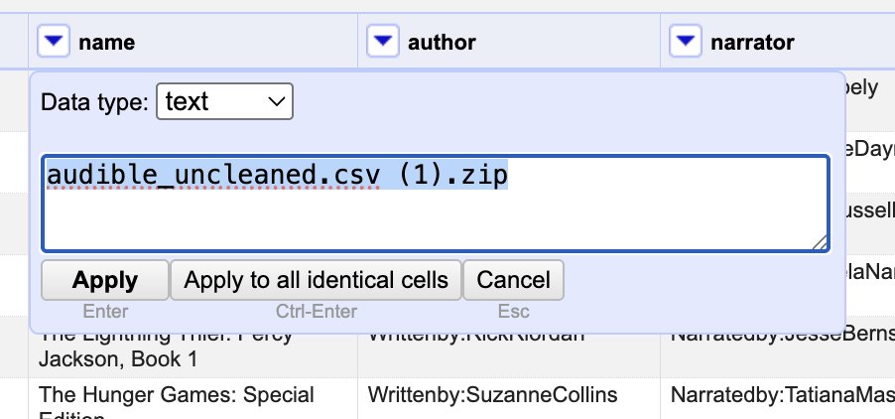
Edits
Hover over a cell.
Clicking edit lets you affect either one cell or every similar cell
Let’s modify the archive column to just be “audible_uncleaned”
Change the text and apply to all
Should see that 87,452 rows were edited
Notes:
Update the CSV to add that column back into it?

Slide 19
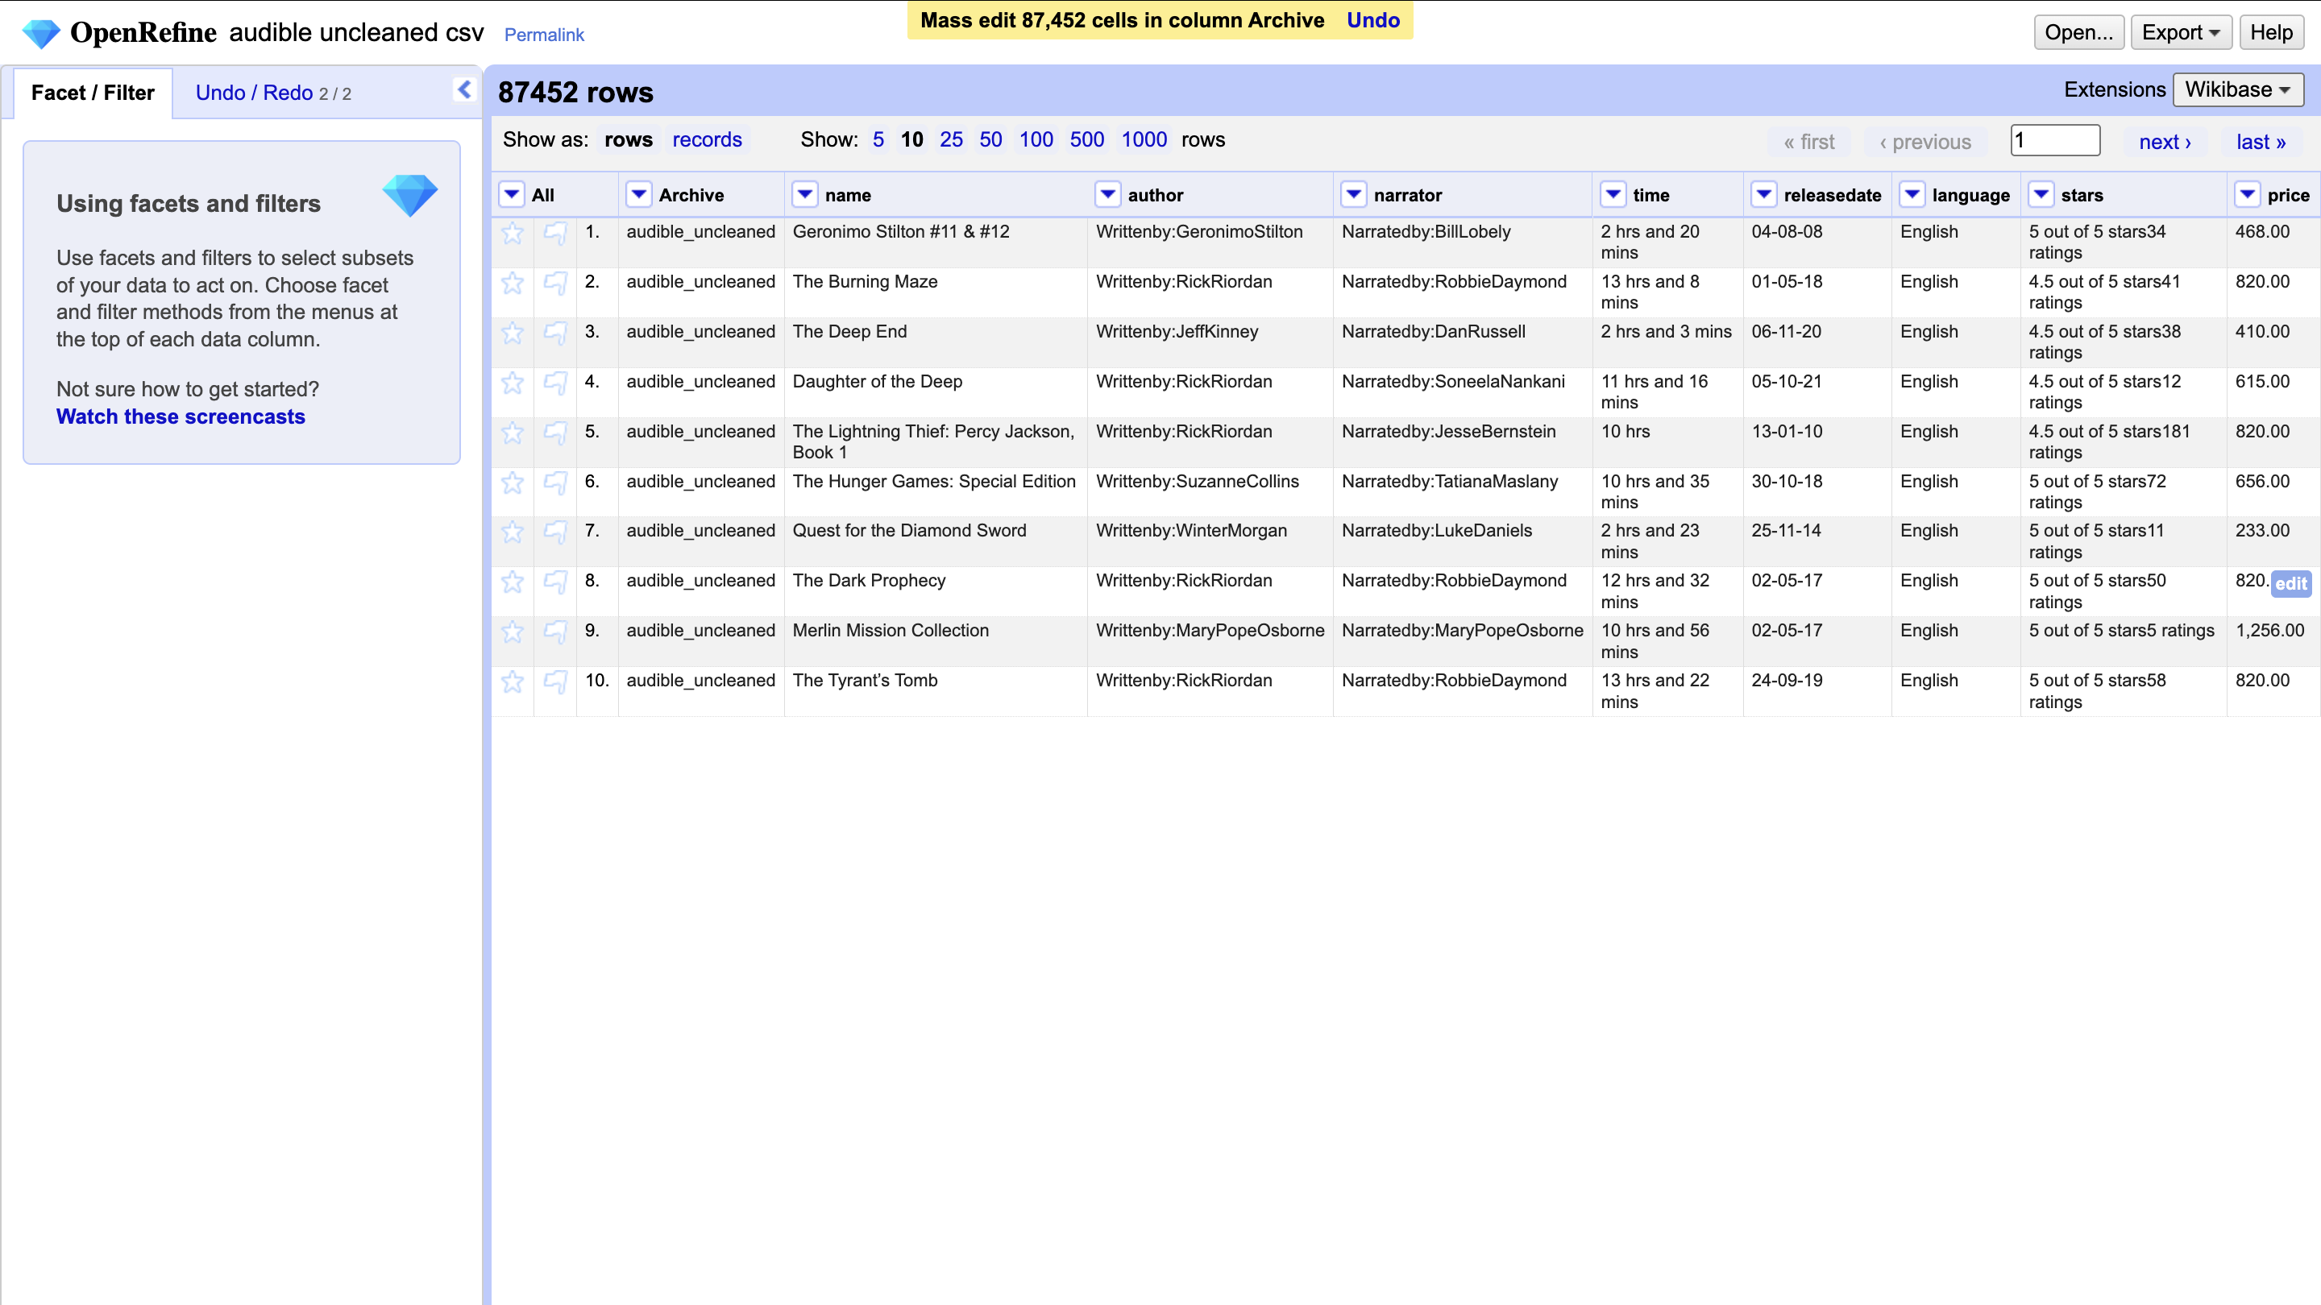
Notes:
Sit with that magic for a second

Slide 20
Repeat
Try to edit the following columns to normalize them in the same way:
Narrator
Author
Did they work?
Note that you can undo your work in the undo menu to get back to a previous state

Slide 21
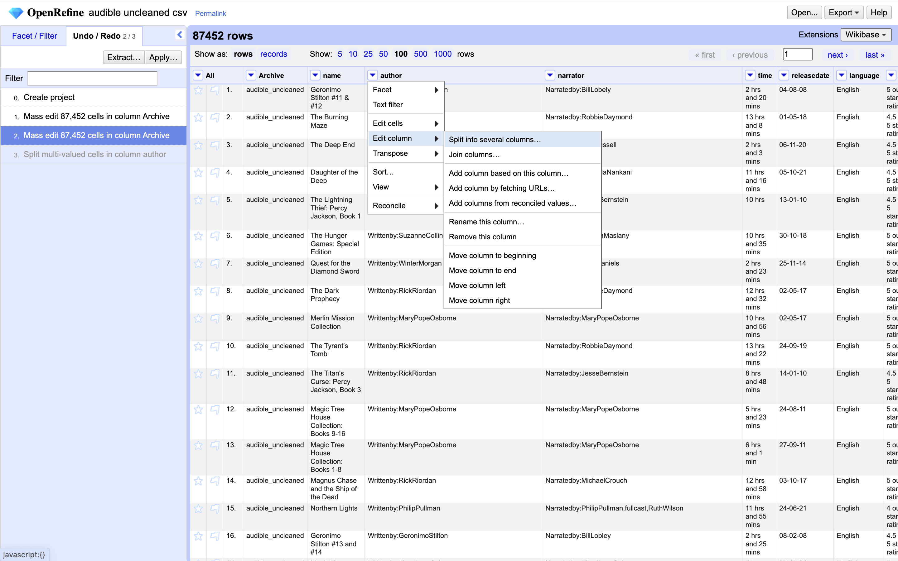
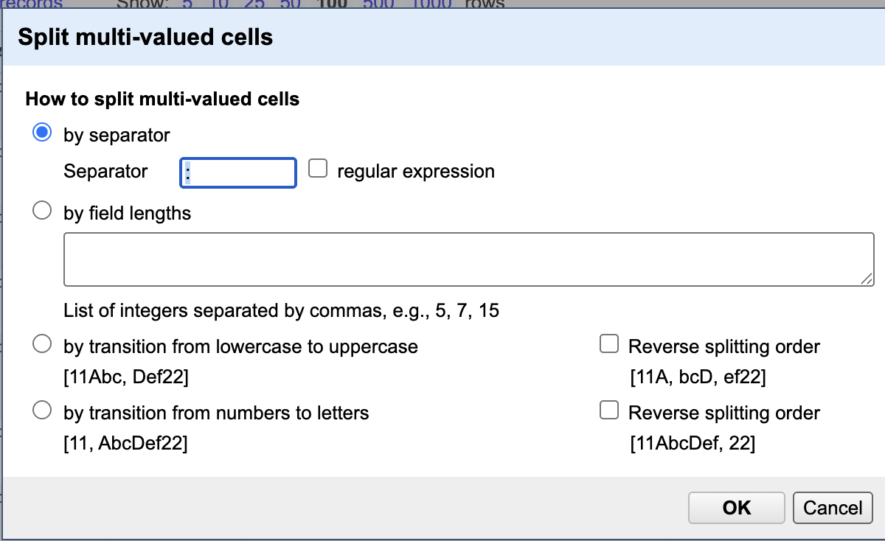
Splitting and Undoing
Try to edit the author field.
Did it work?
Try a couple more mass edits of that column.
An easier thing we can do is split the data into columns and delete that way.
Dropdown on column -> edit column -> split into several columns
Change the separator to ”:”
Should now see two columns split on the colon
If not, explore the undo menu and try again

Slide 22
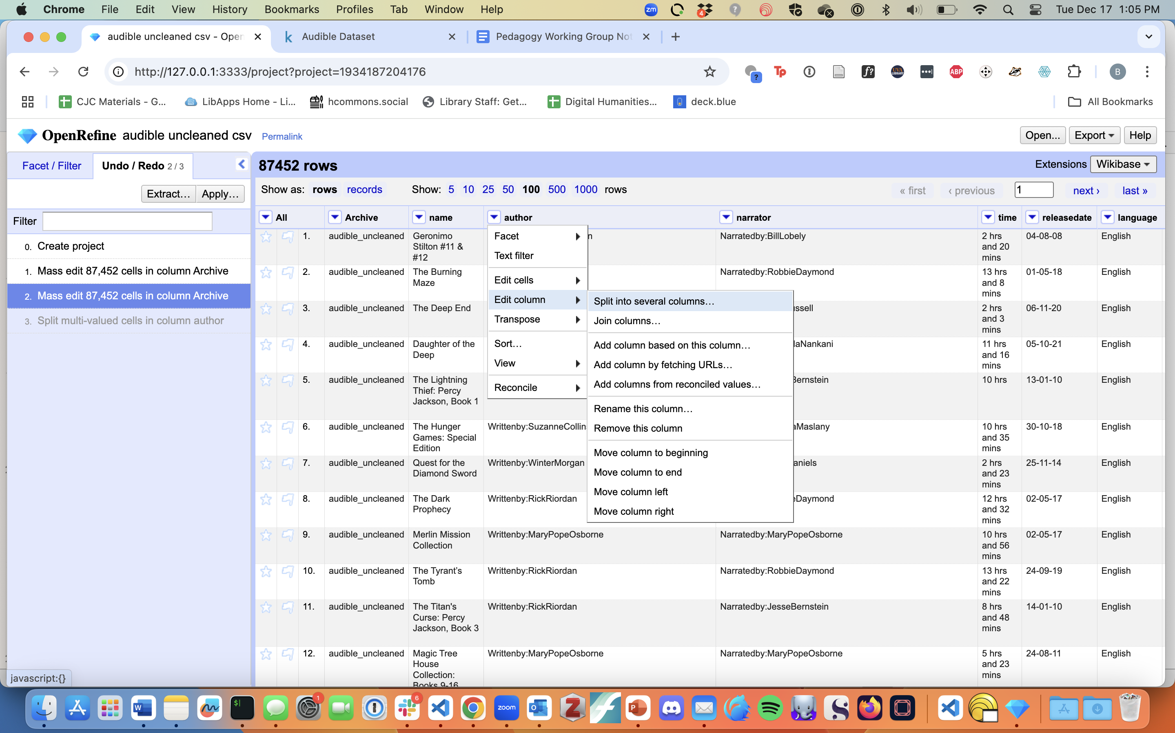
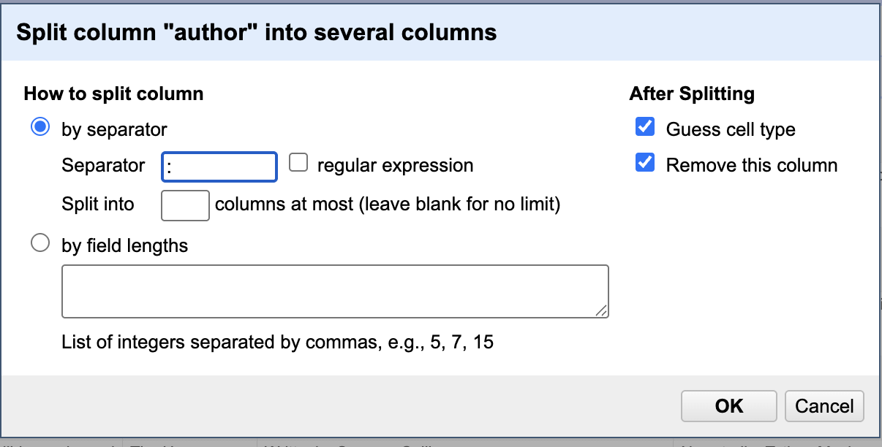
Cleaning Up
Delete the Extra Column
Arrow dropdown -> edit column -> remove column
Do the same thing with narrator column
Split, remove it
That leaves us with two columns named author 2 and narrator 2
Use the edit column function to rename them

Slide 23
Now You Try
Split the stars column into separate columns called “stars” and reviews
You can do this using only what you already know
Feel free to work together!

Slide 24
Now You Try
Split the stars column into separate columns called “stars”
Split on “out of 5 stars”
Rename them

Slide 25
Now You Try
Convert the reviews column to just numbers
Did it work?
How do you know?

Slide 26
Now You Try
Convert the reviews column to just numbers
Did it work?
How do you know?
Hint: change your view to 1000 rows and scroll down to find edge cases
Further tool on next slide

Slide 27
Regular Expressions
The most complicated command + F you can imagine
Complicated set of rules for describing options
“[0-5] out of 5 Ratings” = any number 0-5 followed by ratings
For this, you just need to give options with the | character, as in
tools|tool searches for both singular and plural

Slide 28
Regular Expressions
The most complicated command + F you can imagine
Complicated set of rules for describing options
“[0-5] out of 5 Ratings” = any number 0-5 followed by ratings
For this, you just need to give options with the | character, as in
tools|tool searches for both singular and plural

Slide 29
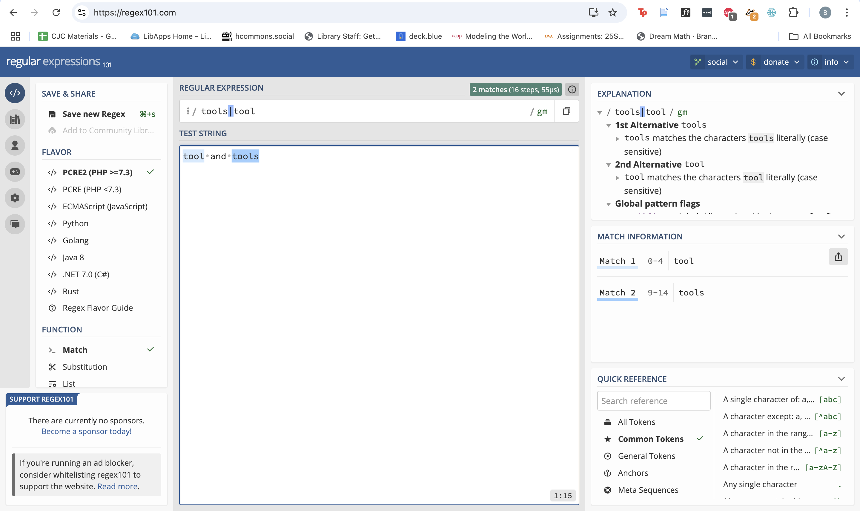

Slide 30
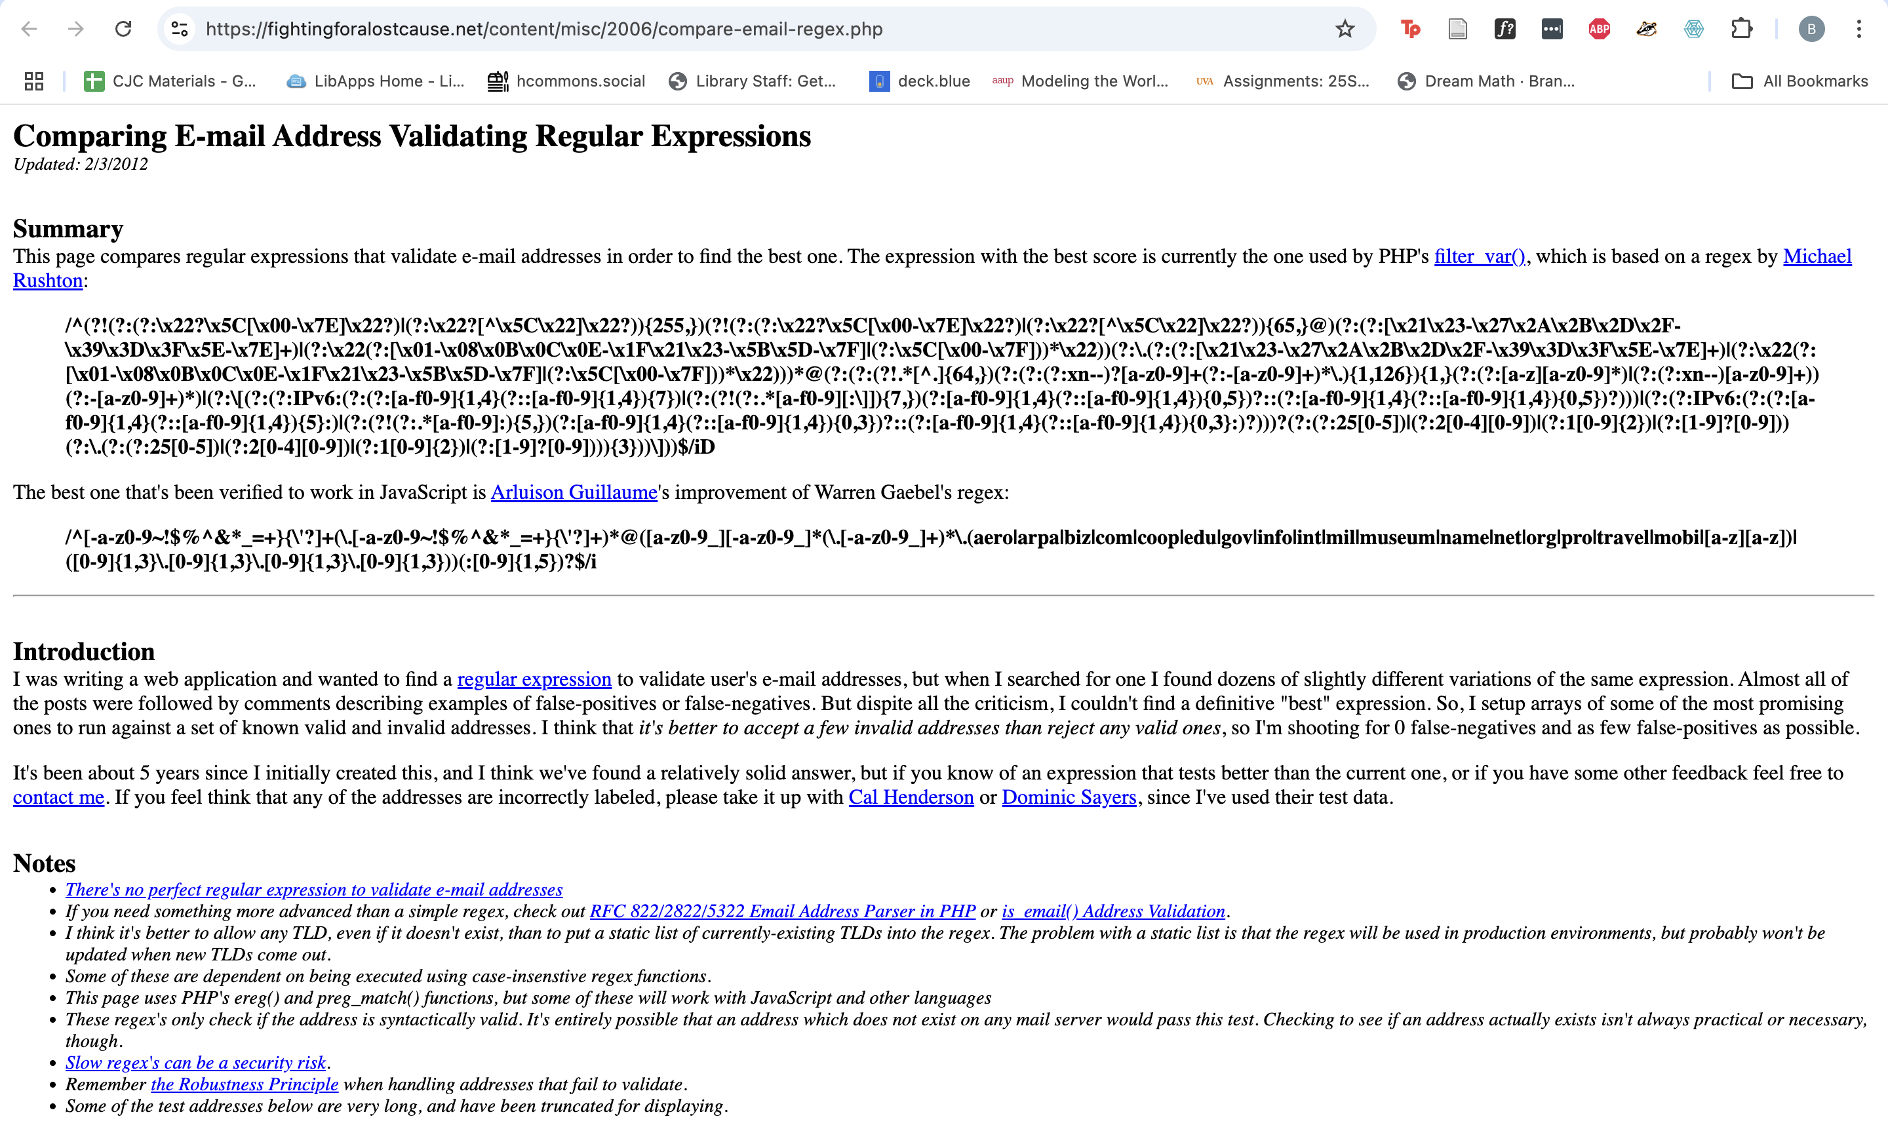

Slide 31
Now You Try
Undo everything so you have the columns together
From the beginning, convert a cell that says “Not rated yet” to “0 out of 5 stars0 ratings” and apply to all
Split “stars” on “out of 5 stars”
Split rating on a regular expression “ratings|rating” (make sure you have regex checked)
Rename and delete the new columns appropriately

Slide 32
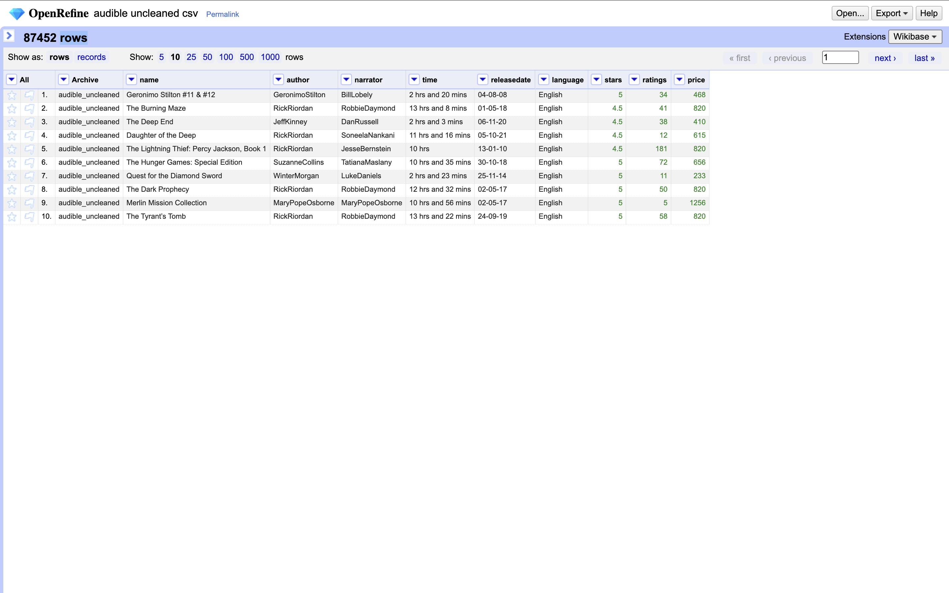
Custom Text Transformations
Eliminate trailing zeros for price
Edit cells -> transformation
Can modify the “value” there
value[0,-3]
Index numbers for each digit -> says “start” to three from the end
Removes our zeroes!
Any problems with the results?
Use a custom transform
value.replace(“,”,””)
Says “replace each comma with nothing
Now use edit cells -> common transformation -> to number convert all into numbers. Can see from the green text

Slide 33
Time
Lets condense hours + minutes into just minutes
Split the column according to spaces
Rename the ones we care about
Remove the columns we don’t want
We should be left with just an hours column and a minutes column
Minutes column will have some blanks in it – edit one to be 0, change to number type, and apply to all

Slide 34
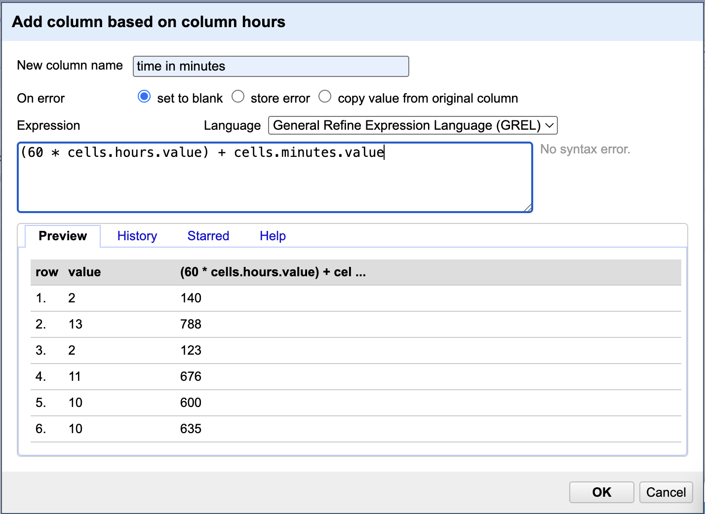
Time cont.
We want to get a new value that is just all the menues
Click on hours dropdown -> add column based on this column
Enter values at right
(60 * cells.hours.value) + cells.minutes.value
Convert hours to minutes and hours and minutes
If we pay attention, that didn’t quite grab all errors
We can look into it by using the sort menu to float blank and error categories to the top

Slide 35
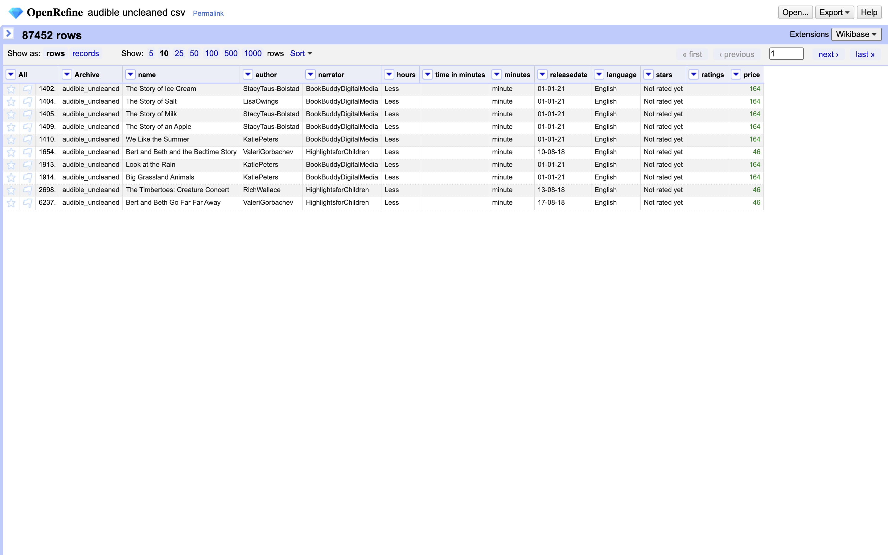
Errors
Lots of issues!
What do you notice?
If we had more time we could work on massaging these out and catching errors
But what did we learn?
No substitute for the human eye
Important to look at the data!
We can see that some audiobooks are less than one hour - didn’t count on that

Slide 36
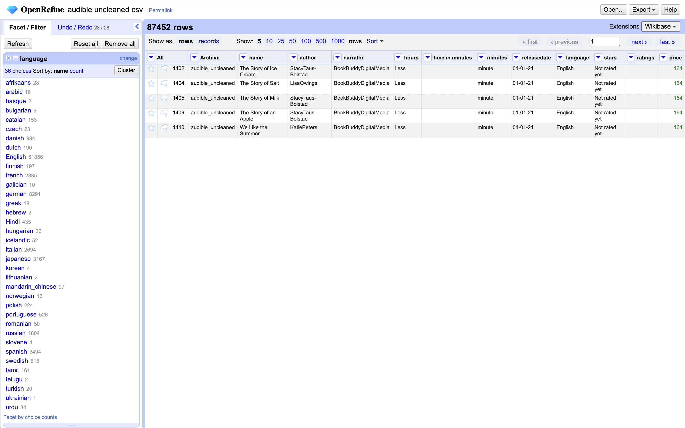
Facets
Open sidebar at left
Give you information about your data
Language column dropdown -> facet -> text facet
Gives you a quick and dirty count of your values

Slide 37
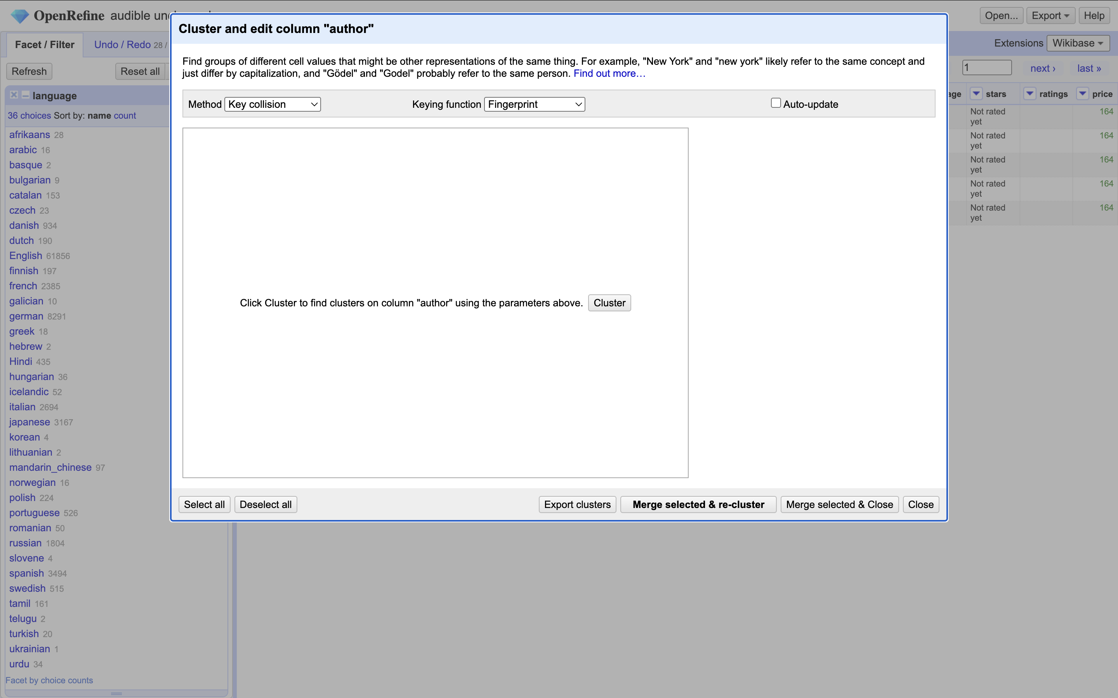
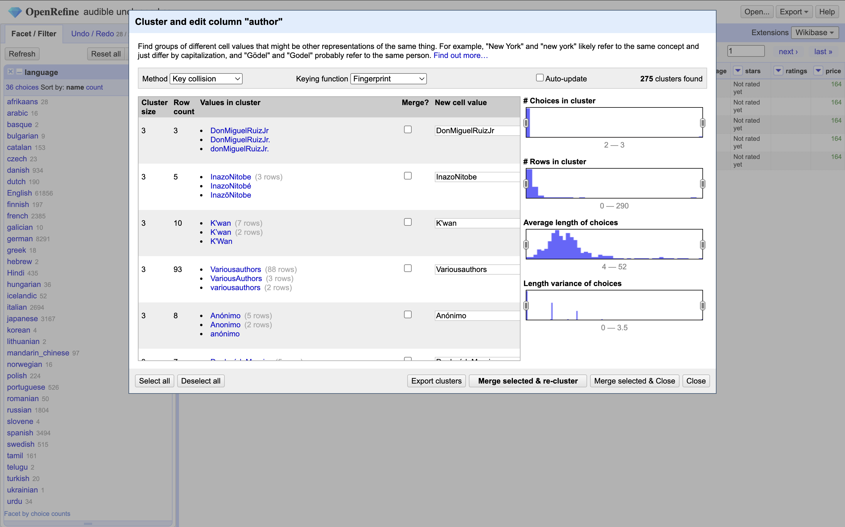
Clustering
Author dropdown -> edit cells -> cluster and edit
Hit cluster
Does some matching to find multiple values that might be the same.
You can then edit and reconcile them to a single value.
Merge selected and recluster will repeat the process
Also called disambiguation
REALLY powerful

Slide 38
Homework
Work through this lesson on The Programming Historian. Send a screenshot of your successful results along by Friday at 9:00 AM.
The lesson is a decade old, so be aware there might be some discrepancies with the instructions/screenshots.
If there turn out to be issues do your best to follow and figure out how to keep going anyway. Send me a list of any problems.

